Slide 1
Chapter 2
Web Development Using HTML
Part II
Notes:
Lecture slides prepared for “Computer Organization and Architecture”, 10/e, by William Stallings, Chapter 2 “Performance Issues”.

Slide 2
Outline
Document structure elements
Text markup elements
Heading elements
Paragraph and line break elements
List elements
Text formatting
Demarcating elements
Quotation markups
HTML Entity and Comment
Image elements
Link elements

Slide 3
1. Document structure elements
meta tags
This meta element defines a description of your page:
<META name="description" content="Free Web tutorials on HTML, CSS, XML, and XHTML" />
This meta element defines keywords for your page: (for search engine)
<META name="keywords" content="HTML, DHTML, CSS, XML, XHTML, JavaScript" />
This demonstrates how to redirect a user if your site address has changed:
<META http-equiv=“Refresh” content=“5;url=http://www.w3schools.com” />
This meta element defines character set:
<META http-equiv="Content-Type" content=“text/html; charset=UTF-8” />

Slide 4
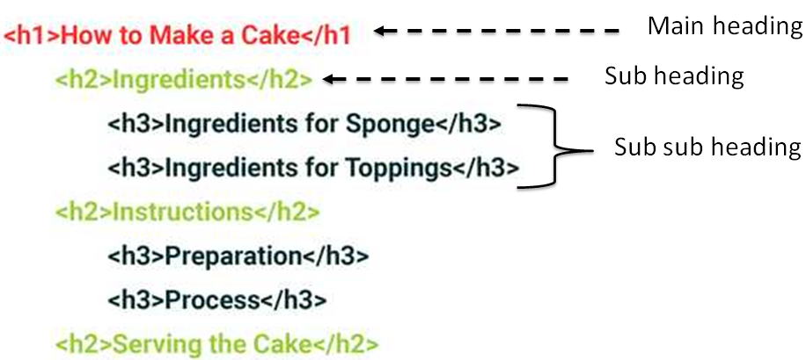
2. Text Markup Elements
(a) Heading elements
In the same way that a book has the main title, chapter titles, and subtitles, an HTML document can too.

Slide 5
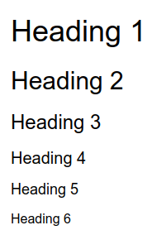
Cont’d
Heading elements
Definition and Usage
Heading elements allow you to specify that certain parts of your content are headings.
HTML contains 6 section heading levels, <h1> to <h6>
The heading element importance level
<h1> define the most important (highest) heading level
<h6> define the lowest (less important) headings.
Commonly 3 to 4 heading elements are used at most.
The heading Tags are block level elements.
It’s content model categories are flow content and heading content
These elements only include the global attributes.

Slide 6
Cont’d
Heading elements
Heading information
Allow search engines to index the structure and content of your web pages
Users often skim a page by its headings and determine the content layout of web page automatically.
Also it is a common navigation technique for users of screen reading software to jump from heading to heading and quickly determine the content of the page.
As a result,
Avoid skipping heading levels: always start from <h1>, followed by <h2> and so on
Use only one <h1> per page or view (considered a best practice)
<h1> should concisely describe the overall purpose of the content.
It is important to use headings to show the document structure.
Avoid using heading elements to resize text (i.e. to make text BIG or bold).

Slide 7
2. Text Markup Elements (cont’d)
(b) Paragraph elements
HTML paragraphs any structural grouping of related content, such as texts, images or form fields.
The <p> HTML element represents a paragraph.
It belongs flow content category.
Paragraphs are block-level elements and.
Always starts on a new line
Browsers automatically add white space (margin) before and after a paragraph.
This element only includes the global attributes.
Breaking up content into paragraphs helps make a page more accessible.
Allow screen-readers to provide shortcuts that let their users skip to the next or previous paragraph, and skim the content.

Slide 8
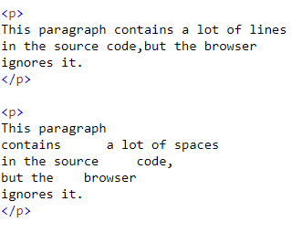

Cont’d
Paragraph elements
HTML <p> content display
Large or small screens, and resized windows will create different results.
With HTML, you cannot change the display by adding extra spaces or extra lines in HTML code.
The browser will automatically remove any extra spaces and lines.
Note:
Don’t use empty <p> which is problematic for people who use screen-reading technology.
Output of the example

Slide 9
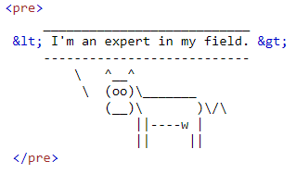
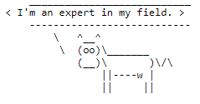
Cont’d
Paragraph elements
<pre> elements
Represents preformatted text which is to be presented exactly as written in the HTML file.
The text is typically rendered using a non-proportional, or "monospaced”, font.
Unlike <p> element, it preserves whitespace both spaces and line breaks:
Provide an alternate description for any images or diagrams.
It is a block-level element which belongs to flow content category
Output

Slide 10
2. Text Markup Elements (cont’d)
(c) Line break elements (<hr> and <br>)
<hr/>
Represents a thematic break between paragraph-level elements:
E.g., a change of scene in a story, or a shift of topic within a section.
Displayed as a horizontal rule in visual browsers.
<br/>
Produces a line break in text (carriage-return).
It is useful for writing a poem or an address, where the division of lines is significant.
Only enter line breaks, not to add space between paragraphs.
Both <hr> and <br> support both global attributes and event attributes
Both are block-level elements,
<hr> is flow content whereas <br> is phrasing content

Slide 11
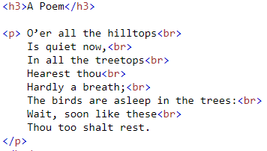
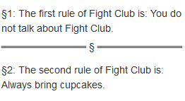
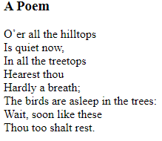
Cont’d
Line break elements
Example
<p> §1: The first rule of Fight Club is: You do not talk about Fight Club. </p>
<hr/>
<p> §2: The second rule of Fight Club is: Always bring cupcakes. </p>
Output
Output

Slide 12
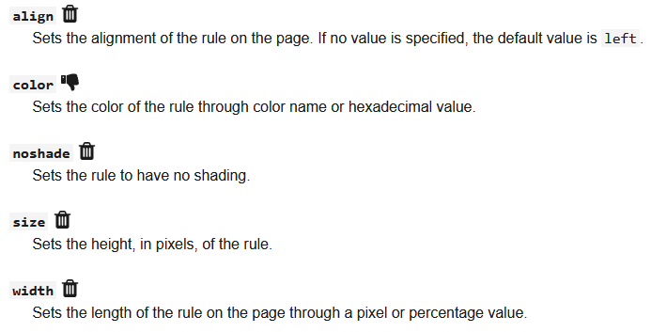
Cont’d
Line break elements
<hr> Attributes

Slide 13
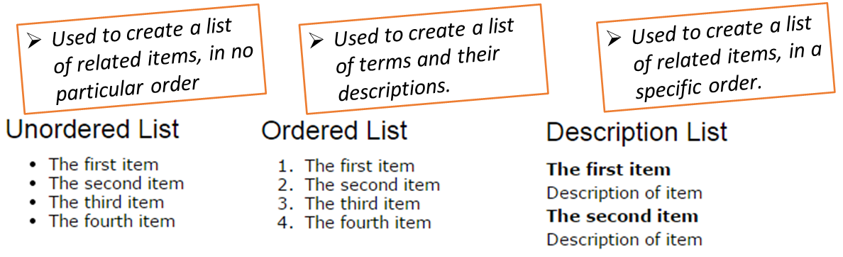
2. Text Markup Elements (cont’d)
(d) List elements
HTML offers web developers mechanisms to group a set of related items in lists
HTML lists are used to present list of information in well-formed and semantic way.
There are three main types of list in HTML, each one has a specific purpose

Slide 14
Cont’d
List elements
Attribute(s) of list elements
No | List element | Attribute(s) | Attribute value(s)
1 | <ul> | type | Circle / disc / square / triangle
2 | <ol> | reversed | Boolean
 |  | type | 1 (default), A / a / I / i
 |  | start | integer - indicates the current ordinal value of list item
3 | <li> | value | Integer - start counting from for the list items.
 |  | type | 1 (default) A / a / I / i
4 | <dd> | nowrap | Yes/no (default), If the value is set to yes, the definition text will not wrap

Slide 15
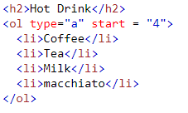
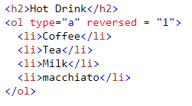
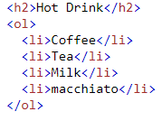
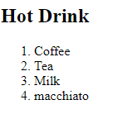
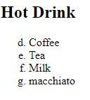
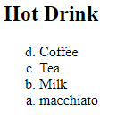
Cont’d
List elements
Example: Ordered list

Slide 16
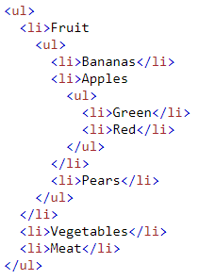
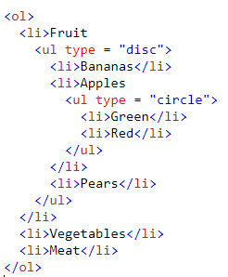
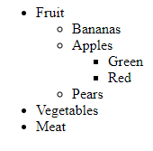
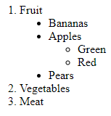
Cont’d
List elements
Example: Unordered list Nested list

Slide 17
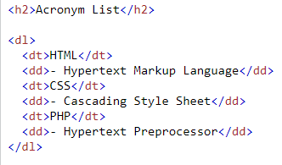
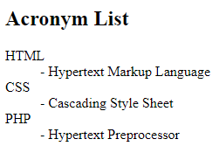
Cont’d
List elements
Example: Description list

Slide 18
Cont’d
(e) Text formatting elements
HTML provides several tags that you can use to make some text on your web pages to appear differently than normal text.
Formatting elements were designed to display special types of text:
Tag | Description
<b> | Defines bold text
<big> | Defines big text
<em> | Defines emphasized text
<i> | Defines italic text
<small> | Defines small text
<strong> | Defines strong text
Tag | Description
<sub> | Defines subscripted text
<sup> | Defines superscripted text
<s> | Renders text with a strikethrough but not important when indicating document edits
<u> | Deprecated. But in use for different purpose

Slide 19
Cont’d
Demarcating and Quotation Elements
Tag | Description
<ins> | Defines inserted text
<del> | Defines deleted text
<mark> | Marked text
<samp> | sample output of a computer program
<code> | To show the computer code - Like a programming code
<kbd> | keyboard input text
<var> | To display the text as a variable - Like Programming variable

Slide 20
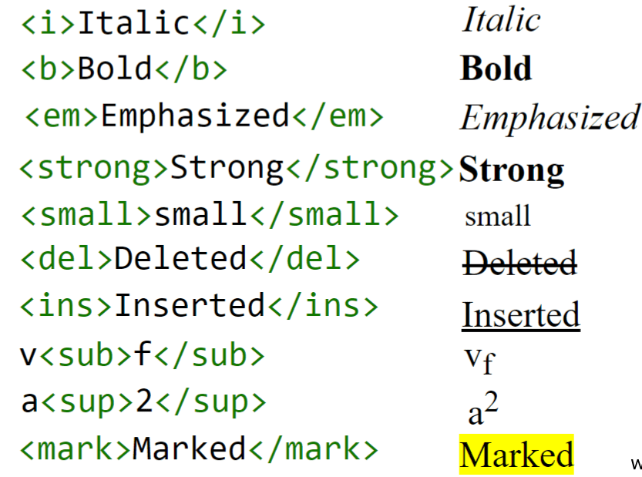
Cont’d
Example

Slide 21
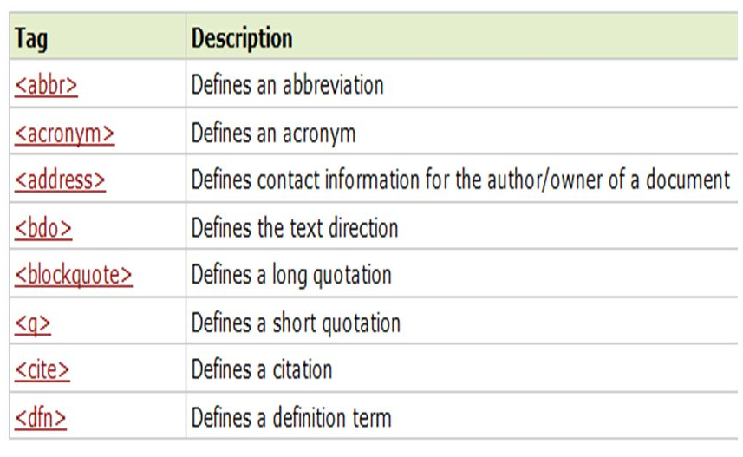
Cont’d
HTML Citations and Definition Elements

Slide 22
3. HTML Entity and Comment
HTML Entity
A piece of text ("string") that begins with an ampersand (&) and ends with a semicolon (;)
Frequently used to display
Reserved characters (which would otherwise be interpreted as HTML code)
Invisible characters (like non-breaking spaces).
Characters that are difficult to type with a standard keyboard.
Syntax:
&entity_name; OR &#entity_number;
An entity name is easy to remember but browsers may not support all entity names. Therefore, the support for entity numbers is good.

Slide 23
Cont’d
HTML reserved character Entities
Character | Description | Entity Name | Entity Number
 | non-breaking space | &nbsp; | &#160;
< | less than | &lt; | &#60;
> | greater than | &gt; | &#62;
& | ampersand | &amp; | &#38;
" | double quotation mark | &quot; | &#34;
' | single quotation mark (apostrophe) | &apos; | &#39;
« | Left-pointing double angle quotation mark | &laquo; | &#171;
» | Right-pointing double angle quotation mark | &raquo; | &#187;

Slide 24

Cont’d
Character | Entity Name | Entity Number | Description
¢ | &cent; | &#162; | Cent
£ | &pound; | &#163; | Pound
¤ | &curren; | &#164; | General currency
€ | &euro; | &#8364; | Euro
¢ | &cent; | &#162; | Cent
© | &copy; | &#169; | Copyright
® | &reg; | &#174; | Registered
™ | &trade; | &#8482; | Trademark
Currency, Copyright and Trade symbols
For the complete character entity reference check out
https://html.spec.whatwg.org/multipage/named-characters.html#named-character-references
https://www.tutorialrepublic.com/html-reference/html-character-entities.php

Slide 25
Cont’d
HTML Comment
The syntax to add comments to your HTML source is as follow
<!-- Write your comments
goes here -->
Notice that there is an exclamation point (!) in the start tag, but not in the end tag.
Used to hide content - comments are not displayed by the browser, but they can help document your HTML source code.
With comments you can place notifications and reminders in your HTML code and improve code readability.

Slide 26
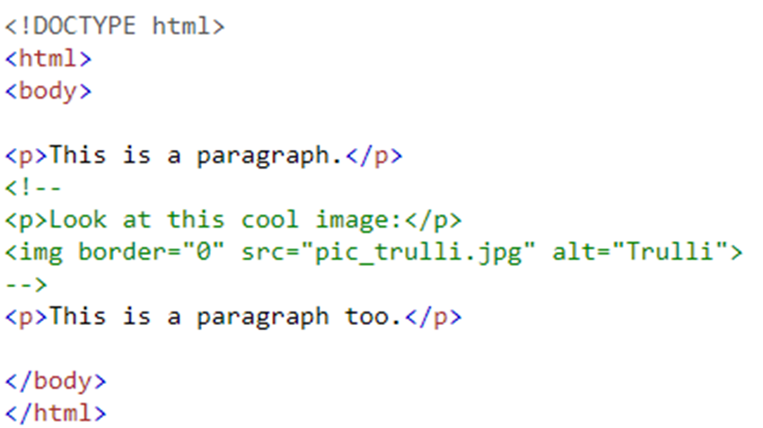

Cont’d
Example: Comment

Slide 27
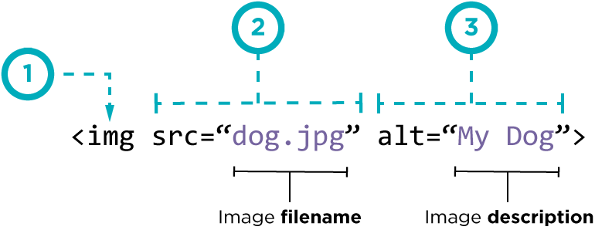
4. Image Element
Images enhance visual appearance of the web pages by making them more interesting and colorful.
The <img> tag is used to embeds images in the HTML documents.
It is an empty element and contains attributes only.
Syntax:
(1) – img is an image tags which embed a given /picture/image
(2) - src attribute is short for source and tells the tag which image to load by specifying it’s path.
(3) – alt attribute is short hand for alternative text

Slide 28
5. Link elements
A hyperlink (or link) is a word, group of words, or image that we can click on to jump to a new document or a new section within the current document
Links are specified in HTML using the anchor (<a>) tag
The <a> tag can be used in two ways:
To create a link to another document, by using the href attribute
To create a bookmark inside a document, by using the name attribute
Syntax : <a href="url">Link text</a>
where “href” attribute can point to:
Outside document
Another document within the same site
Another part of document within the same file

Slide 29
Cont’d
Link to external document
Example:
<a href=“http://www.w3schools.com/”>Visit W3Schools</a>
Attribute “target” specifies where to open the document
Example below opens linked document in a new browser window
<a href=“http://www.w3schools.com/” target=“_blank”>W3Schools</a>
An example of a link to document within the same site
<a href=“./HR/admin_peple.html”>Administrative Staff</a>

Slide 30
Cont’d
Link within document
Use “name” attribute to specify the name of an anchor
The “name” attribute is used to create a bookmark inside an HTML document is invisible to the reader
A named anchor inside an HTML document can be created as follow
<a name=“tips”>Useful Tips </a>
To create a link to the named anchor
Within the same document: <a href=“#tips”>Visit Useful Tips </a>
from another page:
<a href=“http://www.w3schools.com/html_links.htm#tips”> Visit Useful Tips</a>

Slide 31
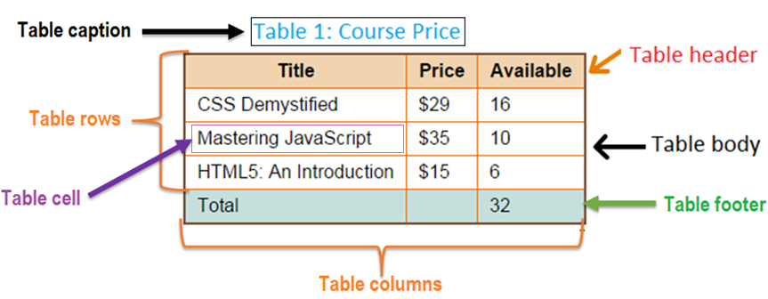
6. Creating Table in HTML
Tables play an essential role in organizing complex data in a simple and logical way, and presenting it in easy follow.
The HTML table model allows authors to arrange data (text, preformatted text, images, links, forms, form fields, other tables, etc.) in tabular.
Before taking a look how to use tables in HTML, let’s take a look at Table structure.

Slide 32
Cont’d
HTML Table Elements
Basic HTML table elements - required tags
Element | tag | Description
Table | <table> </table> | Defines the beginning and end of the table A container tag that that holds the other components of the html table.
Table rows | <tr> </tr> | Defines the beginning and end of a horizontal row. May be grouped into a head, foot, and body sections
Table cells | <td> </td> | Defines an individual cell. Cells are always placed inside a row.

Slide 33
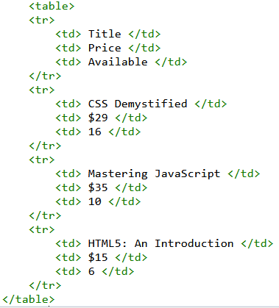
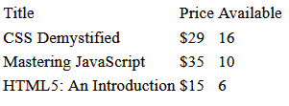
Cont’d
Example 1: Creating a table with default style
Note:
By default table doesn’t have borders

Slide 34
Cont’d
Other HTML table elements – optional tags
Element | tag | Description
Table caption | <caption> </caption> | Specifies the caption (or title) of a table that provides a short description of the table's purpose. Goes after the table tag but not inside “tr” or “td.” Only single caption per table. Appears centered above the table.
Table header | <th> </th> | Defines a table header row. Used instead of “td.” Text is bold & centered within the cell
Table section | <thead> </thead> | Defines a set of rows defining the head of the columns of the table
 | <tbody> </tbody> | Encapsulates a set of table rows (<tr> elements ), indicating that they comprise the body of the table
 | <tfoot> </tfoot> | Defines a set of rows summarizing the columns of the table

Slide 35
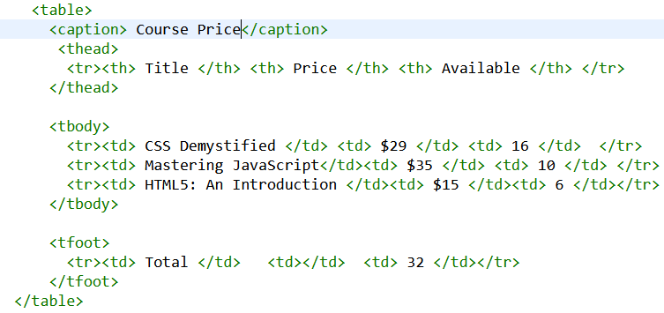
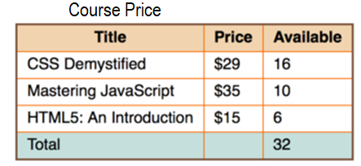
Cont’d
Example 2: Table with caption, header and footer

Slide 36
Cont’d
Table elements attribute
All most all attributes of the table elements are deprecated.
Only <td> and <tr> tags have some attributes described below
<td> tag and <tr> tag attributes
Attribute | Value | Description
colspan | Positive integer <=1000 | Indicates for how many columns the cell extends (span) Its default value is 1
rowspan | Positive integer <=65534 | Indicates for how many rows the cell extends (span). Its default value is 1; if its value is set to 0, it extends until the end of the table section
headers | Header_id | Specifies one or more header cells a table cell is related to
scope | row / col / rowgroup / colgroup | Enumerated attribute defines the cells that the header (defined in the <th>) element relates to

Slide 37
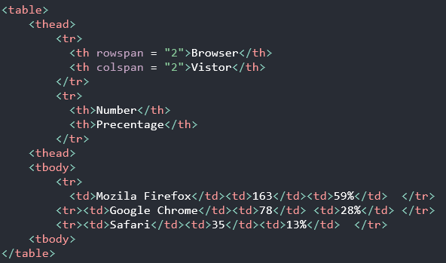
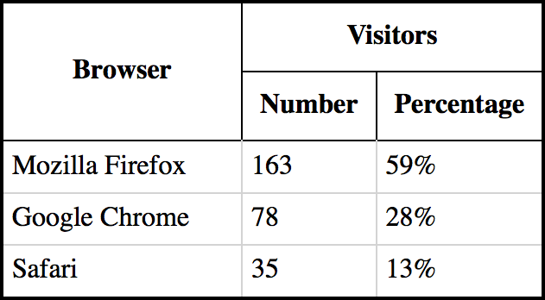
Cont’d
Example 3: Merging Cells with rowspan and colspan attributes

Slide 38
Cont’d
colgroup and col elements
The <colgroup> element
It defines a group of columns within a table for formatting .
It is useful for applying styles to entire columns, instead of repeating the styles for each cell, for each row.
To define different properties to a column within a <colgroup> element, it require the <col> tag
The <col> element
It specifies column properties (common semantics) for each column (all common cells) within a <colgroup> element.
The common semantic (like color, padding etc.) is specified using CSS.

Slide 39
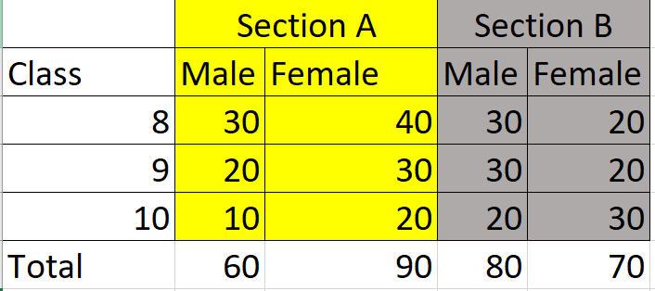
Cont’d
Attributes :
Both elements (<colgroup> and <col>) has single attribute named “span” which a positive integer indicating the number of consecutive columns the elements span.
Example :

Slide 40
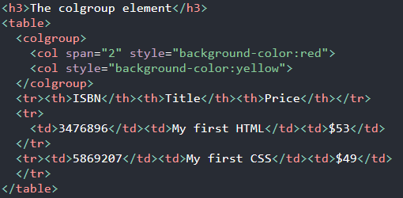
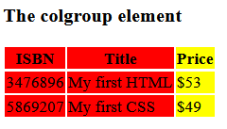
Cont’d
Example – using CSS:

Slide 41
Summary
Root element
Head elements
- title, meta, link, base
Body element
Document structure elements
Text markup elements
HTML Entity and Comment
Image elements
Link elements
Heading elements
Paragraph and line break elements
List elements
Text formatting
Demarcating elements
Citation, Quotation markups
Reserved character entity Special character entity
Comment
Image tag
Figure tag
Figurecaption tag
Ordered list
Unordered list
Description list

Slide 42
Summary
The HTML table model allows authors to arrange data into rows and columns of cells.
Table rows may be grouped into a head, foot, and body sections, (via the THEAD, TFOOT and TBODY elements, respectively.
User agents may exploit the head/body/foot division to support scrolling of body sections independently of the head and foot sections.
Table cells may either contain "header" information or "data".
Cells may span multiple rows and columns
Authors may also group columns to provide additional structural information that may be exploited by user agents.
Each table may have an associated caption that provides a short description of the table's purpose.

Slide 43
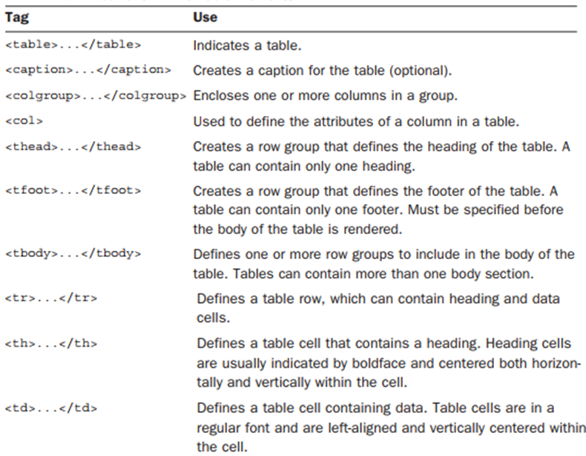
Summary
Current HTML5 Table Elements

Slide 44
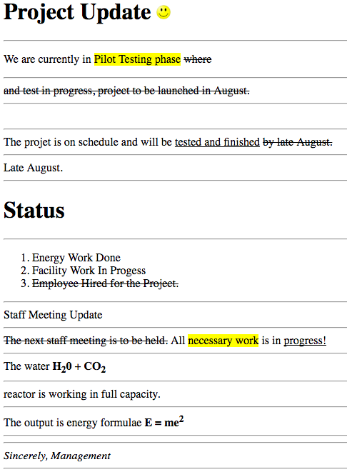
Chapter Activity
Differentiate

Slide 45
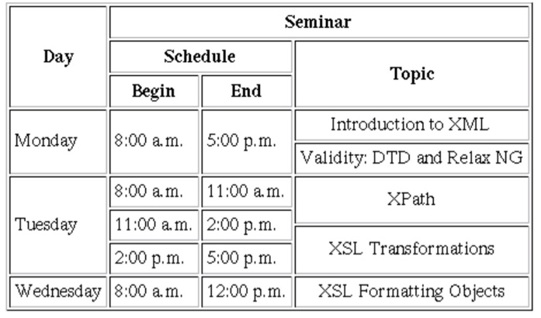
Exercise
Discuss when to use table and things that are appropriate in tables.
Can a table nested, putting a table inside a single table cell?
What are the basic parts of a table, and which tags identify them?
[Practical exercise] Write a HTML code that produce the table below.

Slide 46

Thank You
For Your Attention!!

